Slide 1
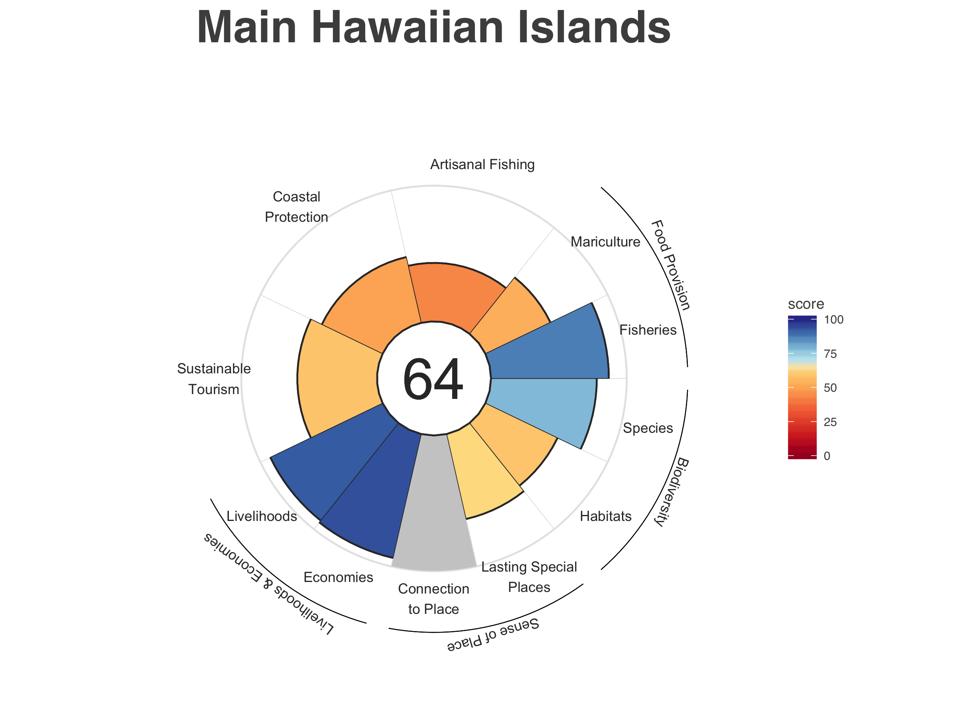
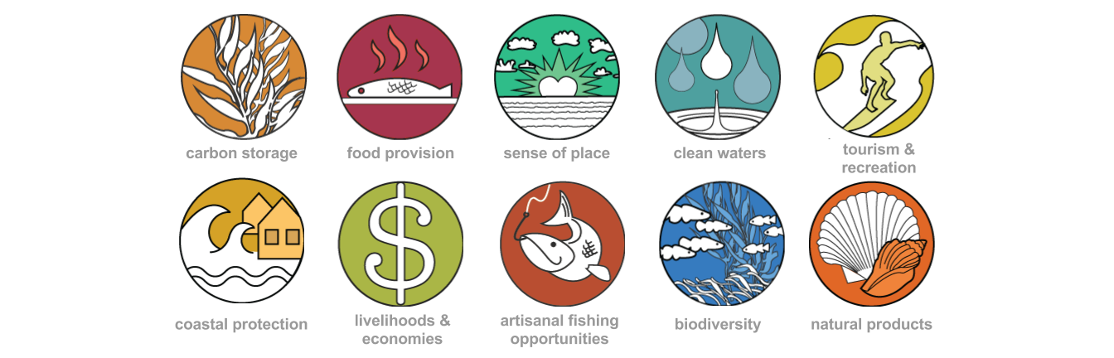
85 wild caught fisheries
46 mariculture
Text for scores or major messages here
Scores are from 0 to 100 and reflect the ability of our ocean to provide sustainable benefits to Hawaii now and into the future

Slide 2
87

Slide 3







Food Provision
Artisanal Fishing Opportunities
Sense of Place
Sustainable Tourism
Biodiversity
Coastal Protection
Livelihoods & Economies

